Slide 1

Team Name : Proj_224781_Team_3
Project Name : Smart Water Fountain
Team Members :
UDAY PRATAP V M (113321104103)
VADDIBOINA PATTABHIRAMI REDDY (113321104105) VAKATI VIKRAM ADITAYA REDDY (113321104109) VATRAPU VISHNU VARDHAN REDDY (113321104111)

Slide 2
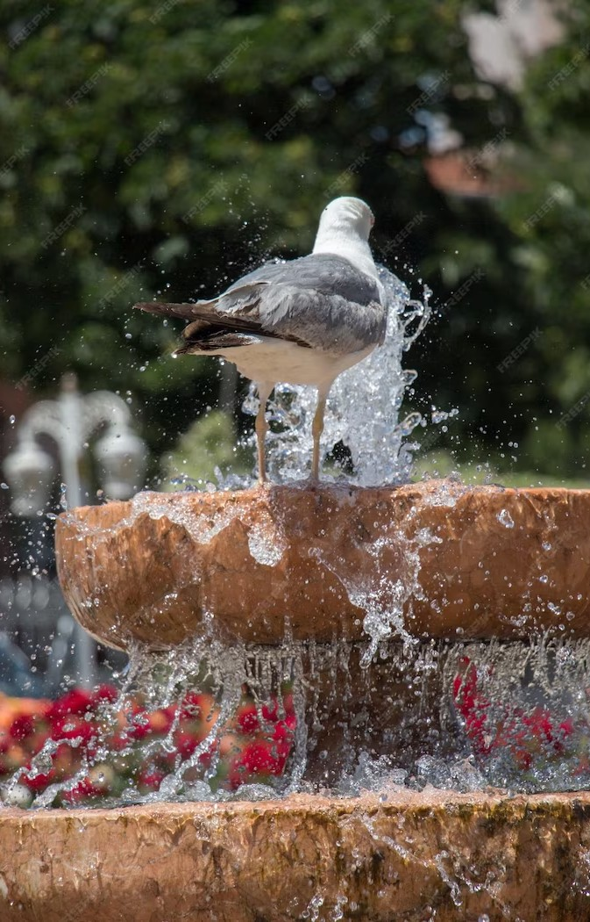
Revolutionizing Hydration:
The Smart Water Fountain and Sustainable Water Consumption

Slide 3
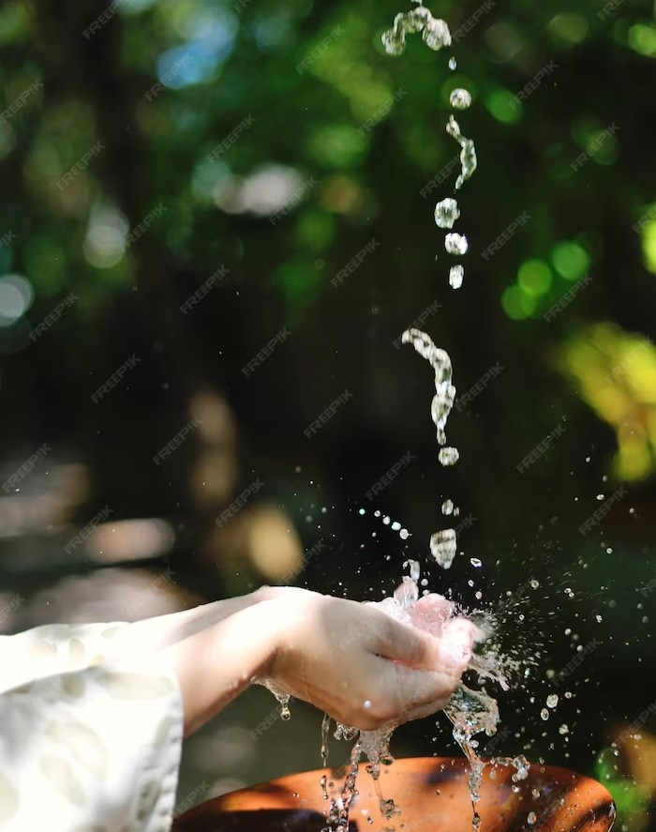
Introduction
Welcome to our presentation on revolutionizing hydration with smart water fountains. Our solution aims to promote efﬁcient and sustainable water consumption. By leveraging technology, we can provide an innovative solution to a common problem. Let's dive in!

Slide 4
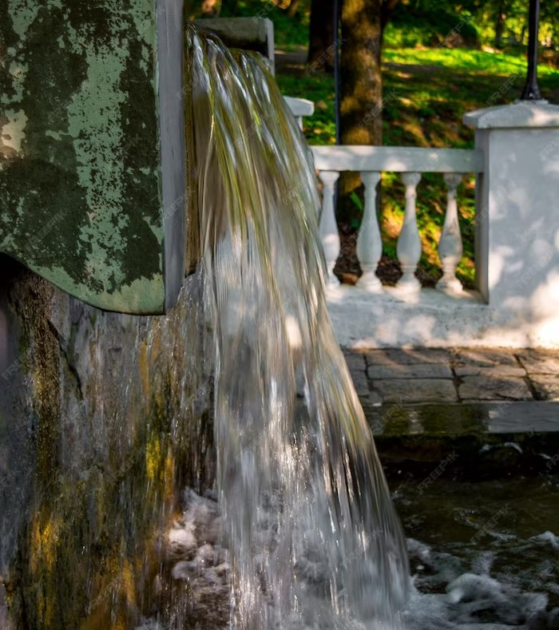
The Problem
Traditional water fountains waste a signiﬁcant amount of water due to inefﬁcient design and user behavior. This leads to unnecessary water consumption and high costs for building owners. Additionally, the COVID-19 pandemic has highlighted the need for touch-free solutions to reduce the spread of germs.

Slide 5
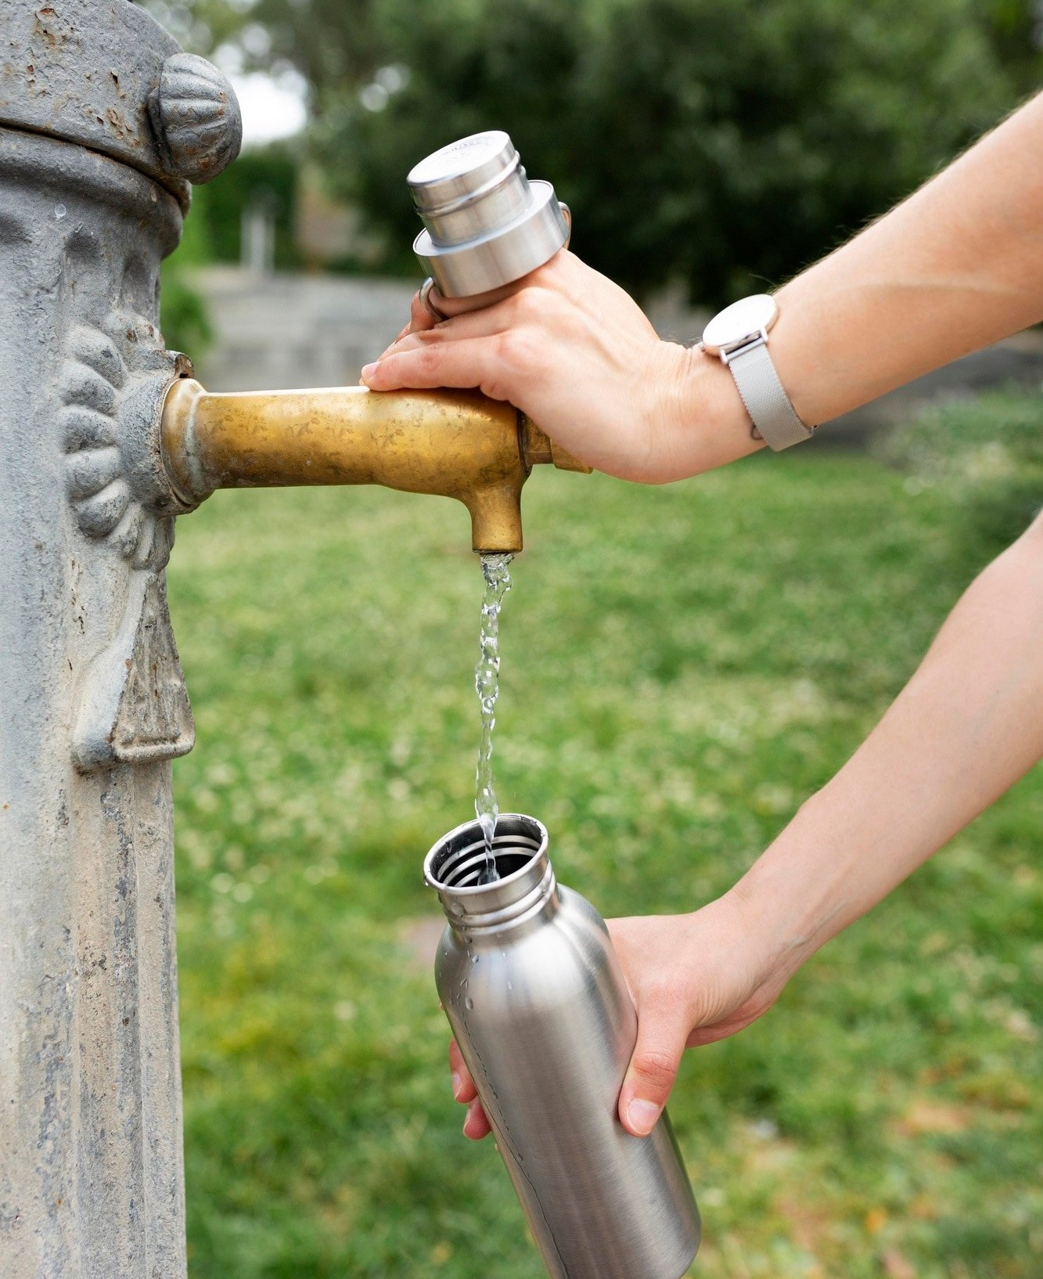
The Solution
Our smart water fountain solution addresses the problems of traditional fountains by incorporating sensors and touch-free technology. Users can easily reﬁll their reusable water bottles without wasting water. Building owners can save on water costs and promote sustainability. The data collected by the sensors can also provide insights into user behavior and water consumption patterns.

Slide 6
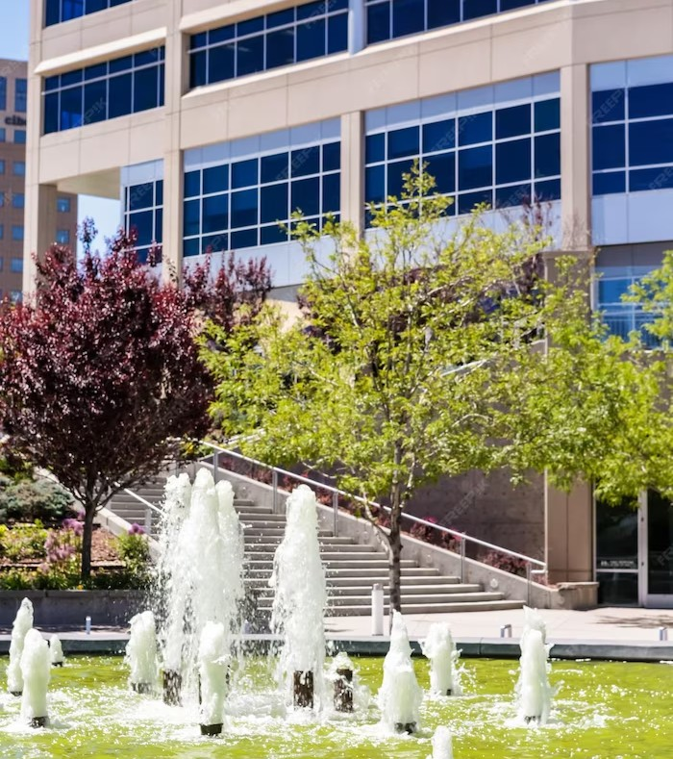
The Beneﬁts
By using our smart water fountain solution, building owners can save money on water costs and promote sustainability. Users can easily reﬁll their reusable water bottles without wasting water. The touch-free technology also reduces the spread of germs, making it a safer option during the COVID-19 pandemic. The data collected by the sensors can provide valuable insights into user behavior and water consumption patterns, allowing for further optimization.

Slide 7
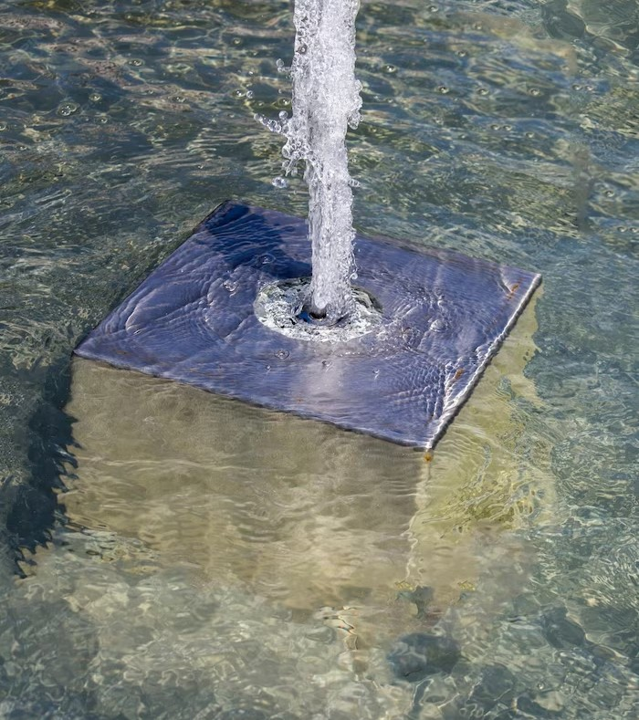
The Technology
Our smart water fountains incorporate sensors and touch-free technology to provide an innovative solution to traditional water fountains. The sensors detect when a user approaches and dispenses an appropriate amount of water for reﬁlling a water bottle.
The touch-free technology ensures that users can reﬁll their bottles without touching the fountain, reducing the spread of germs.

Slide 8
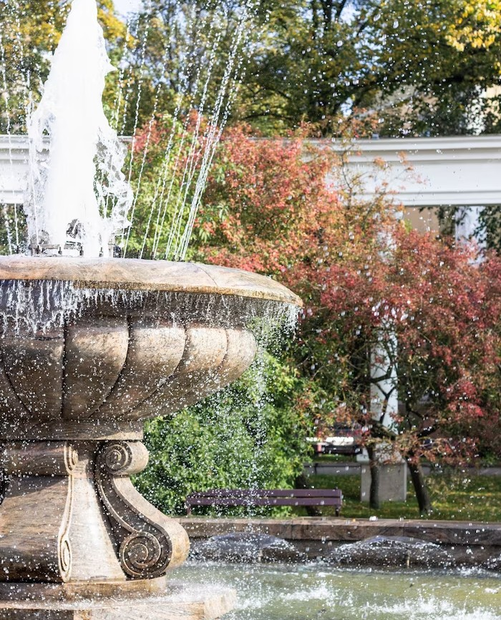
The Market
Our smart water fountain solution is targeted towards building owners and facility managers who are looking for sustainable and efﬁcient solutions to traditional water fountains. With the increasing focus on sustainability and the need for touch-free solutions during the COVID-19 pandemic, our solution is well-positioned to meet the needs of the market.

Slide 9
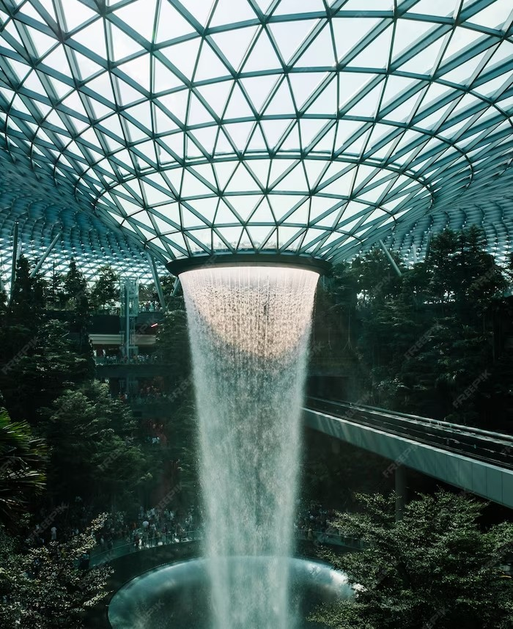
The Future
As we continue to focus on sustainability and efﬁcient resource usage, we believe that our smart water fountain solution will become a standard feature in buildings.
The data collected by the sensors can provide valuable insights into user behavior and water consumption patterns, allowing for further optimization. We envision a future where our solution is the norm, promoting sustainable and efﬁcient water consumption.

Slide 10
Conclusion
Our smart water fountain solution provides an innovative and sustainable solution to traditional water fountains. By incorporating sensors and touch-free technology, we can promote efﬁcient water consumption and reduce the spread of germs. The data collected by the sensors can provide valuable insights into user behavior and water consumption patterns, allowing for further optimization. We believe that our solution is the future of water fountains and will become a standard feature in buildings.

Slide 11
Thanks!

